Slide 1
Responsive Layout

Slide 2
What is Responsive Layout
Pages change/”not change” according to the screen
Demo
DemoRem

Slide 3
How to change according to the screen
1. Media query
2. Using percentage
3. Write different styles and load according to the screen
4. VW/VH , em,rem …
5. etc.

Slide 4
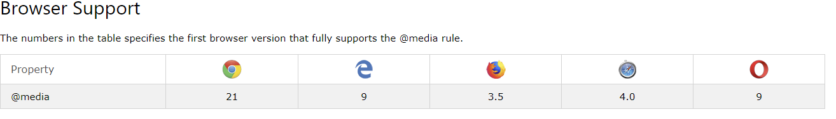
Media query
Demo

Slide 5
Parameters
1. Media types
all: Suitable for all devices.
print: Intended for paged material and documents viewed on a screen in print preview mode.
screen: Intended primarily for screens.
speech: Intended for speech synthesizers.
2. Media features
Media features describe specific characteristics of the user agent, output device, or environment. Media feature expressions test for their presence or value, and are entirely optional. Each media feature expression must be surrounded by parentheses.(e.g width,height,color,scan etc.)
3. Logical operators
The logical operators not, and, and only can be used to compose a complex media query. You can also combine multiple media queries into a single rule by separating them with commas.

Slide 6
How to use?
1.Use inline media query
@media screen and (max-width:600px){background-color:purple;}
@media screen and (max-width:800px){background-color:blue;}
2.Use media query to dynamically load style
<link rel=“stylesheet” media=“screen and (max-width:600px)” href=“demo.css”>
<link rel=“stylesheet” media=“screen and (max-width:800px)” href=“demo2.css”>

Slide 7
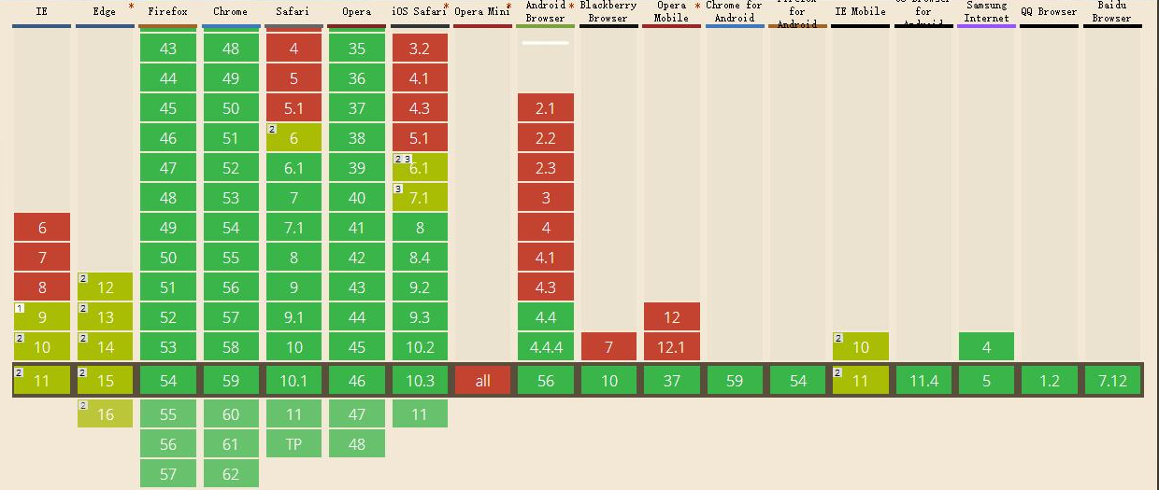
VW VH
Vw: Percentage of the width (1vw stands for 1% of the screen width)
Vh: Percentage of the height

Slide 8
Some basic knowledge about responsive layout
1. Viewport
2. Dpr (Device pixel ratio)
3. PPI(Pixels Per Inch)

Slide 9
Viewport
The viewport is the part of the webpage that the user can currently see. The scrollbars move the viewport to show other parts of the page.
E.g:
<meta name="viewport" content="width=device-width, initial-scale=1.0, maximum-scale=1.0, user-scalable=no" />
Demo

Slide 10
Attributes
Width:Width of the viewport in pixels (or device-width). If width isn't set, it defaults to a desktop size
Height：Height of the viewport in pixels
initial-scale:(0 to 10.0) Sets the scale of the page after its initial display.
minimum-scale:(0 to 10.0) The minimum multiplier the user can "zoom out" to.
maximum-scale:(0 to 10.0) The maximum multiplier the user can "zoom in" to.
user-scalable:(yes/no) Whether to allow a user from scaling in/out (zooming in/out)

Slide 11
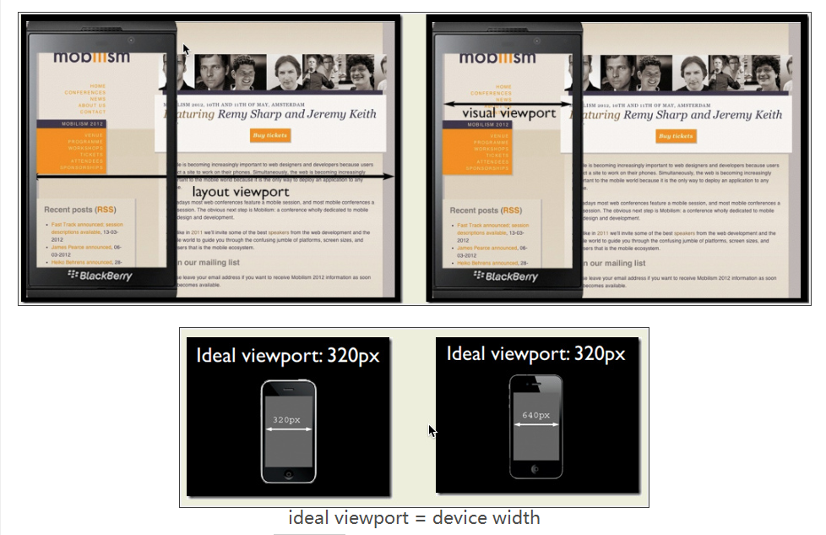
Layout viewport & visual viewport &Ideal viewport

Slide 12
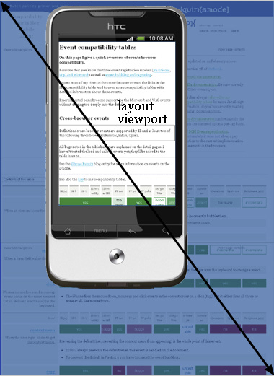
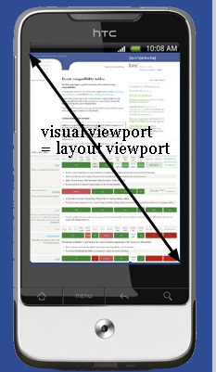

Slide 13
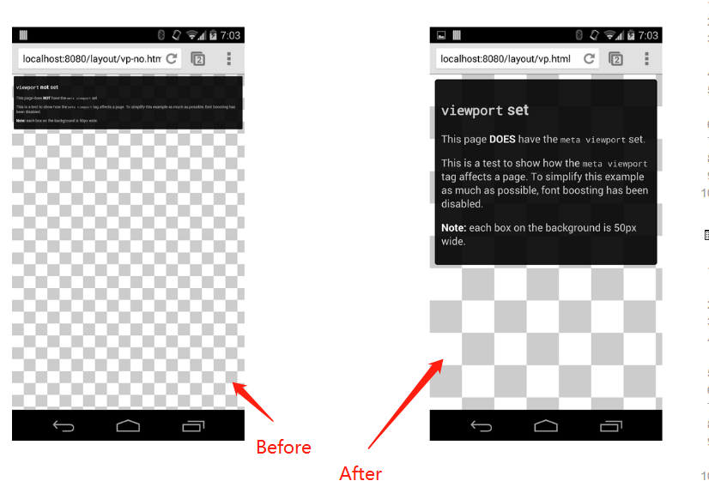

Slide 14
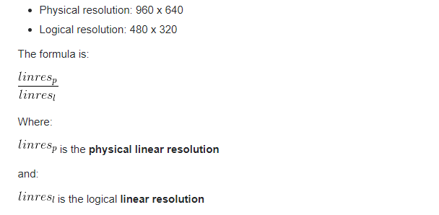
Dpr
Device pixel ratio
The device pixel ratio is the ratio between physical pixels and logical pixels. For instance, the iPhone 4 and iPhone 4S report a device pixel ratio of 2, because the physical linear resolution is double the logical linear resolution. Use window.devicePixelRatio to get the dpr

Slide 15
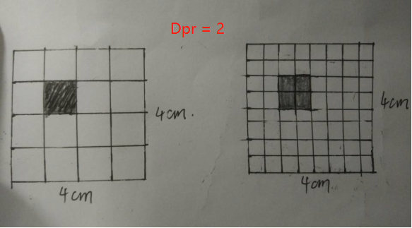
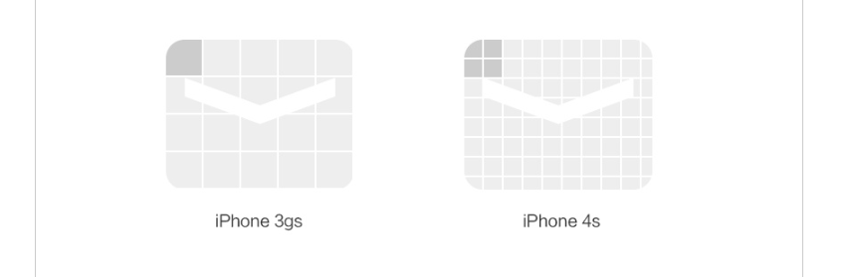

Slide 16
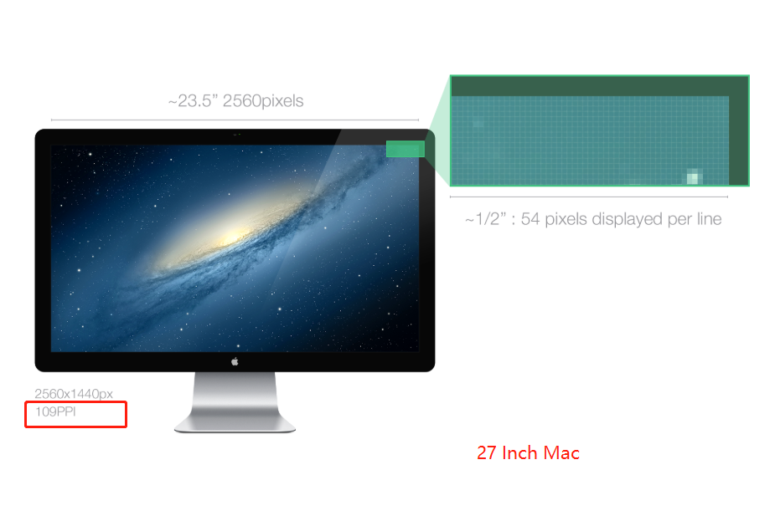
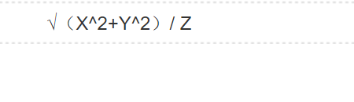

PPI(Pixels Per Inch)
2560^2+1440^2/27

Slide 17
Demo
“1px” problem
Demo

Slide 18
Rem
CSS3 introduces a few new units, including the rem unit, which stands for "root em“, this almost always means the font size of the <html> element

Slide 19
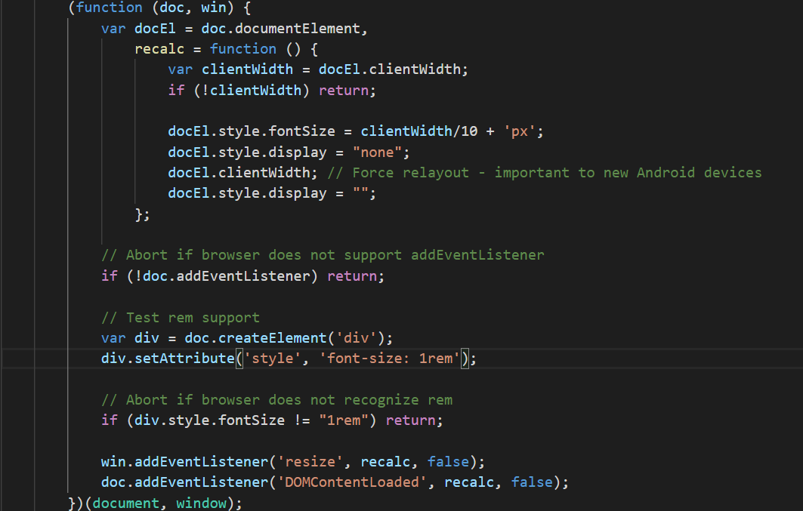

Slide 20
References
1. https://www.w3schools.com/cssref/css3_pr_mediaquery.asp
2. https://developer.mozilla.org/en-US/docs/Web/CSS/Media_Queries/Using_media_queries
3. https://snook.ca/archives/html_and_css/font-size-with-rem
4. https://en.wikipedia.org/wiki/Viewport
5. https://stackoverflow.com/questions/2939693/what-is-viewport-in-html
6. https://stackoverflow.com/questions/8785643/what-exactly-is-device-pixel-ratio
7. https://css-tricks.com/theres-more-to-the-css-rem-unit-than-font-sizing/
8. https://quirksmode.org/mobile/viewports.html
9. https://www.cnblogs.com/2050/p/3877280.html

Slide 21
Thanks
Xie.hai.bran.gu@dnvgl.com

